Slide 1
Which is true? The score function f(h,r,t) …
has always larger values for triples (h,r,t) that are part of the known knowledge graph than for other triples
maps triples to vectors in the embedding space
is always positive
is optimized by stochastic gradient descent
Notes:
Answer C
The score function is a dissimilarity function that goes to zero when the facts are correct.
Answer A is exactly the opposite of the behavior of the score functions. As for Answer B, the score function maps tripes into real numbers, not vectors. And finally SGD optimizes the loss function not the score function.

Slide 2
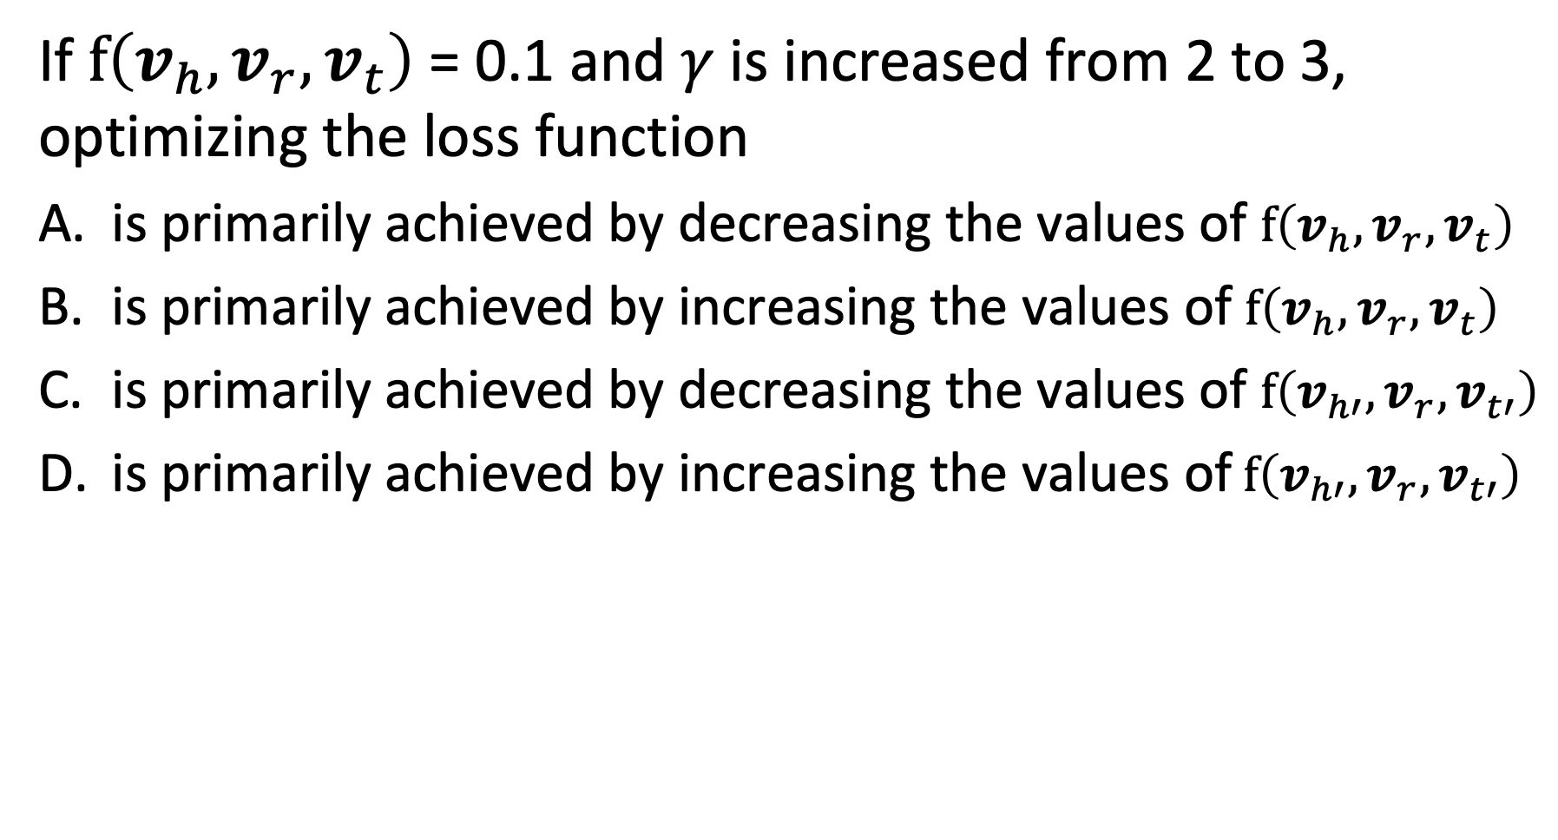
Question
If $f\left(v_{h}, v_{r},v_{t}\right)$ = 0.1 and $γ$ is increased from 2 to 3, optimizing the loss function
is primarily achieved by decreasing the values of $f\left(v_{h}, v_{r},v_{t}\right)$
is primarily achieved by increasing the values of $f\left(v_{h}, v_{r},v_{t}\right)$
is primarily achieved by decreasing the values of $f\left(v_{h′}, v_{r},v_{t′}\right)$
is primarily achieved by increasing the values of$f\left(v_{h′}, v_{r},v_{t′}\right)$
Notes:
Answer D
Since the score function for $f\left(v_{h}, v_{r},v_{t}\right)$ us already almost zero, the increase in margin can only be achieved by increasing the scores for the implausible triples, $f\left(v_{h′}, v_{r},v_{t′}\right)$.

Slide 3
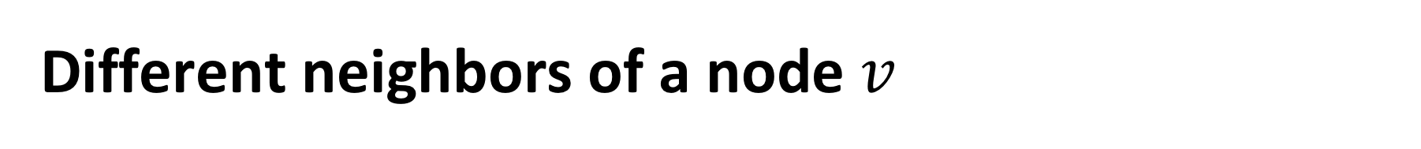
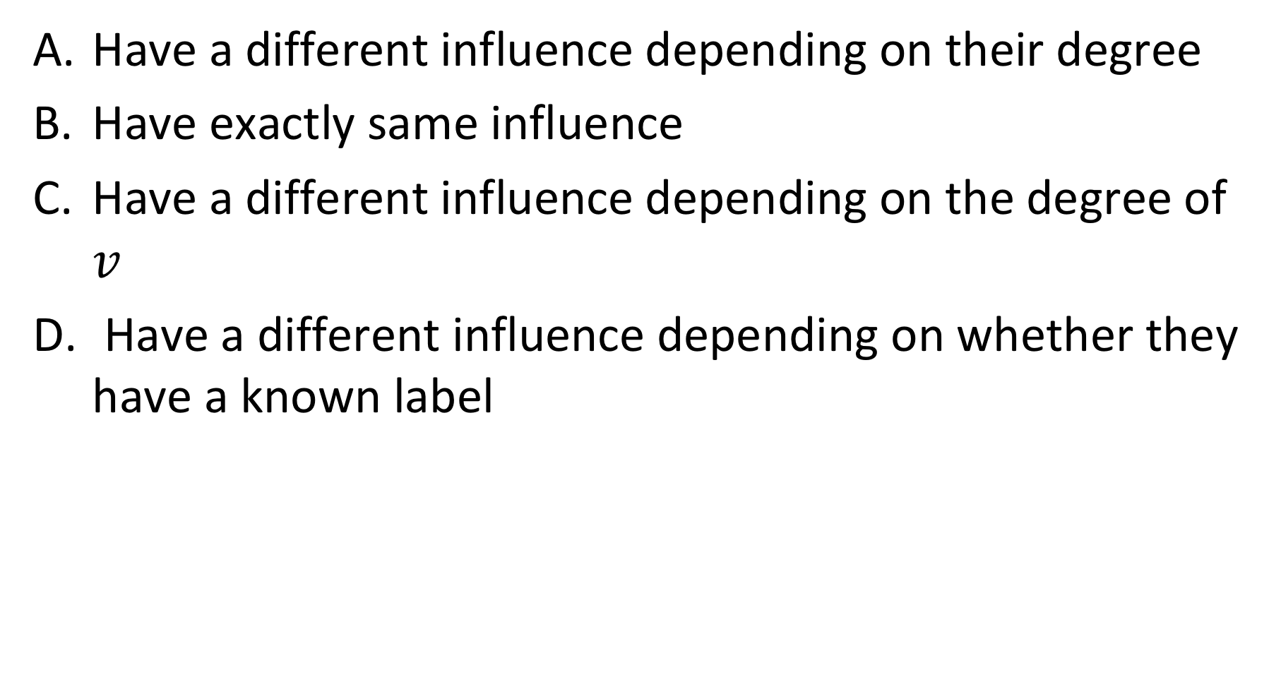
Different neighbors of a node $v$
Have a different influence depending on their degree
Have exactly same influence
Have a different influence depending on the degree of $v$
Have a different influence depending on whether they have a known label
Notes:
Answer C is incorrect, since the degree of a node v has no influence of how it is updated by its neighbors.
For a similar reason also answer D is incorrect. The fact that a node has a known label does not influence how it is updated by the neighbors.
Answer B is not correct since neighbors have different influences, e.g. depending on their node degrees.
Answer A is correct, as the degree of neighbors determines their influence.

Slide 4

The probabilities $p_{v}^{inj}$, $p_{v}^{con}$ and $p_{v}^{aba}$ depend on
The node degree
The pre-existing knowledge on labels
On both node degree and pre-existing knowledge
On further factors
Notes:
Answer C
The probabilities take clearly into account the node degrees. For each node they also depend on whether a pre-existing label exist or not, thus depend on the pre-existing knowledge.

Slide 5
Question
In the proposed schema matching approach, classifiers are constructed
for one schema using as training data the universe of the database
for each class of one schema using as training data the features of the instances of the class
for each class of both schemas using as training data the universe of the database
for each class of both schemas using as training data the features of all instances of the universe of the database
Notes:
Answer 4
The classifiers are trained using the features of instances of the universe (this excludes answers 1 and 3 already).
The classifiers are trained per class, for both schemas, using as training data the features of the whole universe, which serve as positive and negative examples of the members of the class.

